Slide 1
Use of Teensy instead of Arduino Nano
Case study

Slide 2
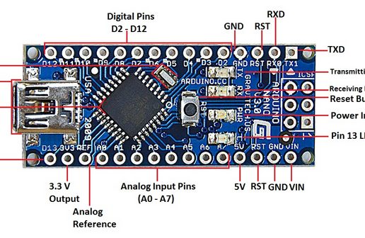
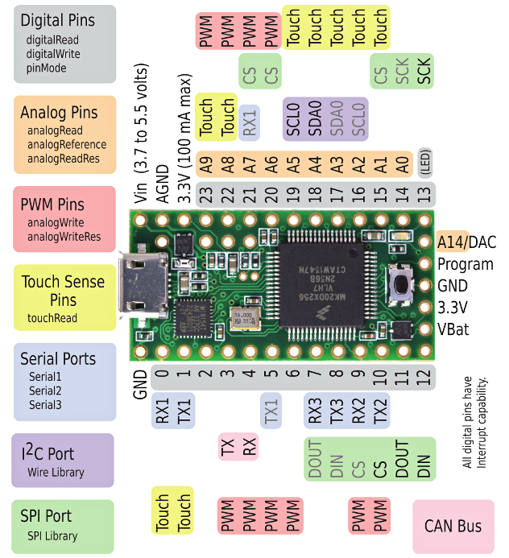
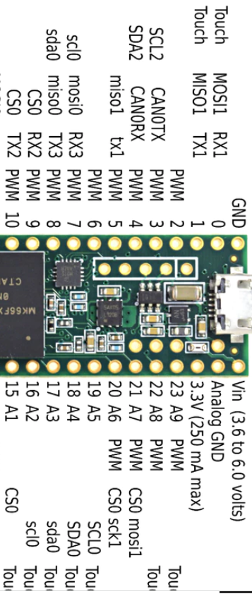
Use Teensy 3.5 or 3.2 in place of Arduino Nano
X) Need to cut and reroute A6 (KeyP) to original A0, used resistor
Use 2 x 11 pin header
X) Must remove pin 19 (3.3 V)
Need to use software I2C
Solder USB cable (green =D+, white=D-) to bottom of teensy
Teensy 3.2
(4 SPI pins stick out)
Arduino Teensy 3.x Application
GND GND GND
D2 D0 D0
D3 D1 D1
D4 D2 D2
D5 D3 D3
D6 D4 A0,TFTDC
D7 D5 A1
D8 D6 SELR1
D9 D7 SELR2
D10 D8 A2
D11 D9 A0’ ..
D12 D10 ENLCD1
D13 A1 ENLCD2
A0 A4 --- (to make KEYP)
A1 A5 ---
A2 A6 LCD4,TFTCS
A3 A7 LCD5,TFTSCK
A4 A8 LCD6, I2C,TFTMOSI
A5 A9 LCD7, I2C
A6 X (3.3 V) --- (was KEYP)
A7 --- (AGND) ---
5V Vin 5V
Teensy 3.5
Sticks far out of
Nova board
Use pins 24-32 as GPIO (5V tol)
Use pins 33-34 as Serial (5 V tol)
USB cable
N
C
N
C
X
N
C

Slide 3
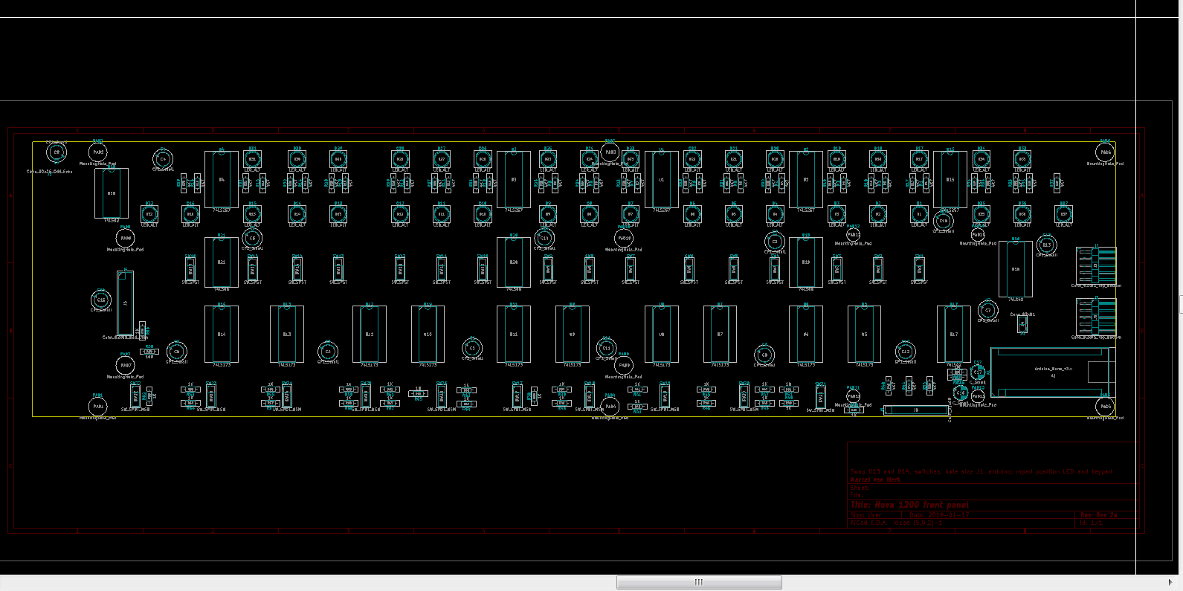
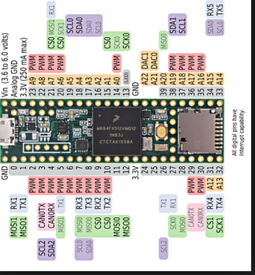

Slide 4
NC LC7 - LC4 Nc KP NC E2
I I I I I I I I I I I
N = not connected on Nova board
X = other use on Nova board
←Analog I/O →
SERIAL
N
x
N
N
← GPIO 8 bits →
I I I I I I I I I I I D0 - D3 A0-1 R1-2 A2-O’ E1

Slide 6
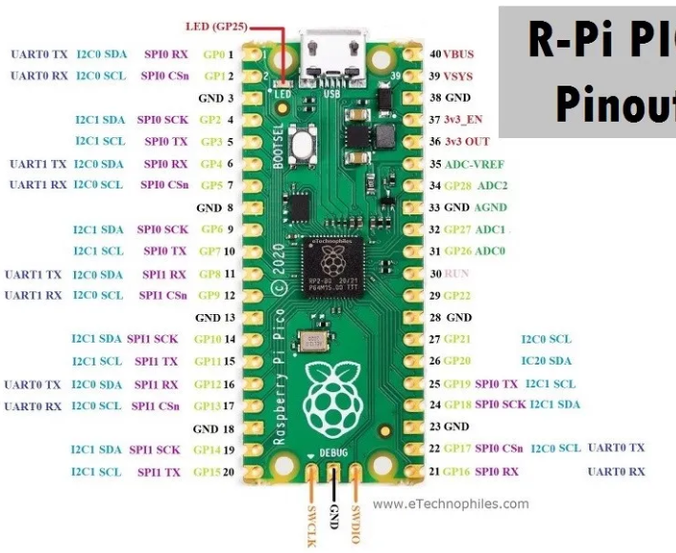
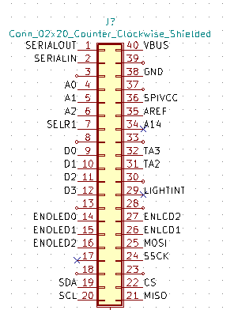

Slide 7
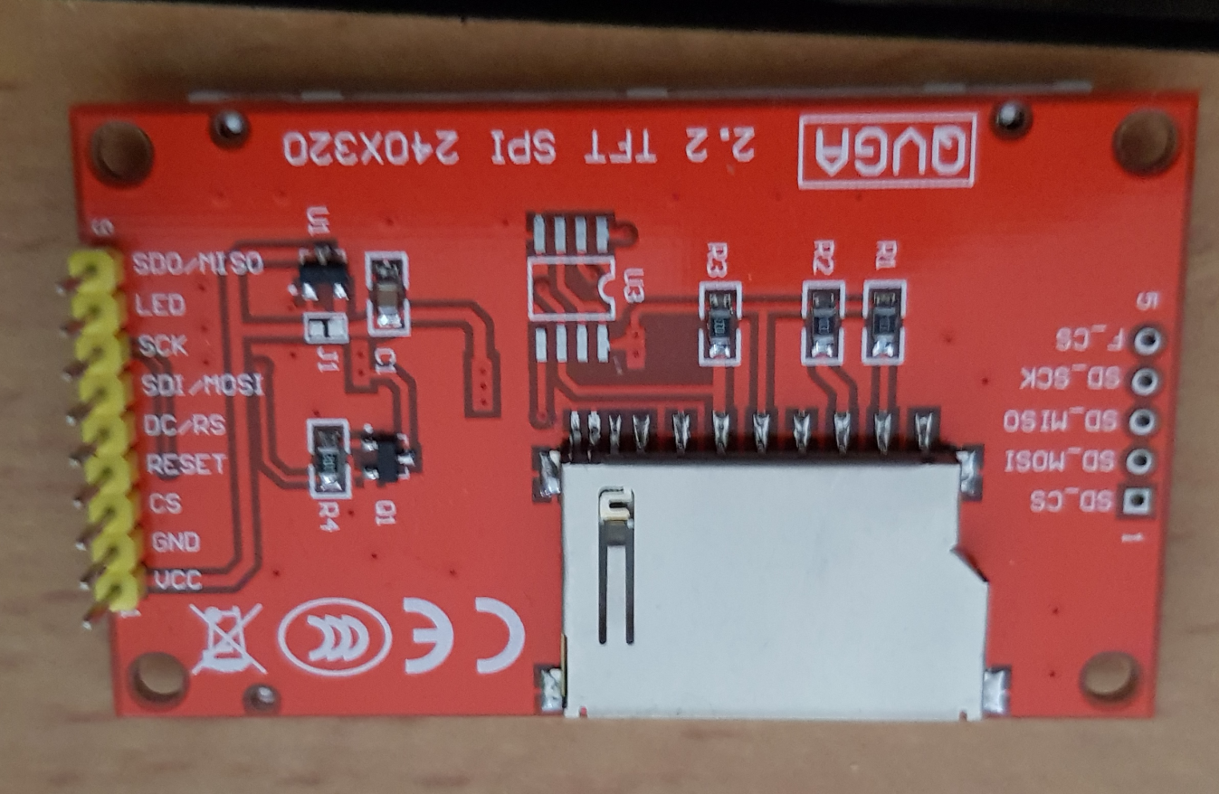
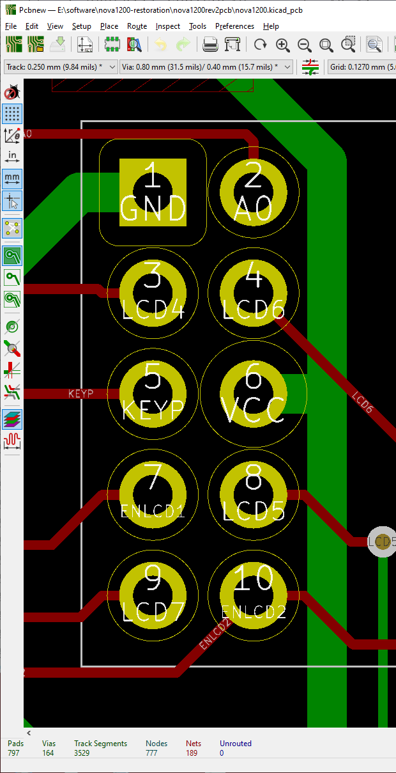
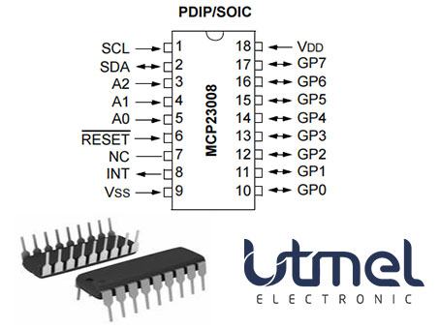
vcc
gnd
led
led
led
gnd
led

